Slide 1

The National University of Computer and Emerging Sciences
Dimensionality Reduction
Machine Learning for Data Science
Dr. Akhtar Jamil
Department of Computer Science

Slide 2
Goals
Review of Previous Lecture
Today’s Lecture
Dimensionality Reduction
Principal Component Analysis

Slide 3
Review of Previous Lecture

Slide 4
Density-based Clustering
All clustering methods use almost the same approach
Calculate similarities and then add to the cluster
k-means is generally good, but:
Need to specify the number of clusters in beginning
K-Means may fail for different shapes.
Outliers can affect its performance ;
A slight change in data points might affect the clustering outcome.
DBSCAN clustering can overcome these.

Slide 5
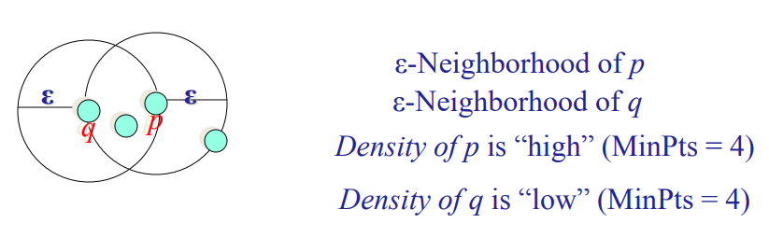
DBSCAN Clustering Algorithm
The DBSCAN algorithm uses two parameters:
eps (ε): A distance measure that will be used to locate the points in the neighborhood of any point.
minPts: The minimum number of points (a threshold) clustered together for a region to be considered dense.

Slide 6
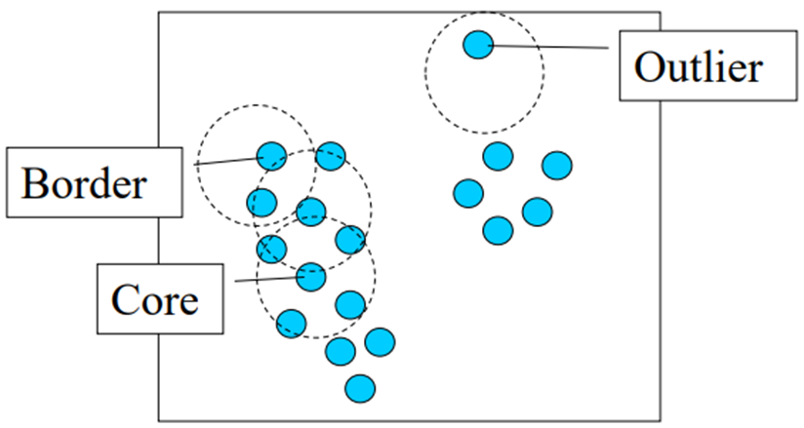
DBSCAN Clustering Algorithm
ε = 2, minPts = 4

Slide 7
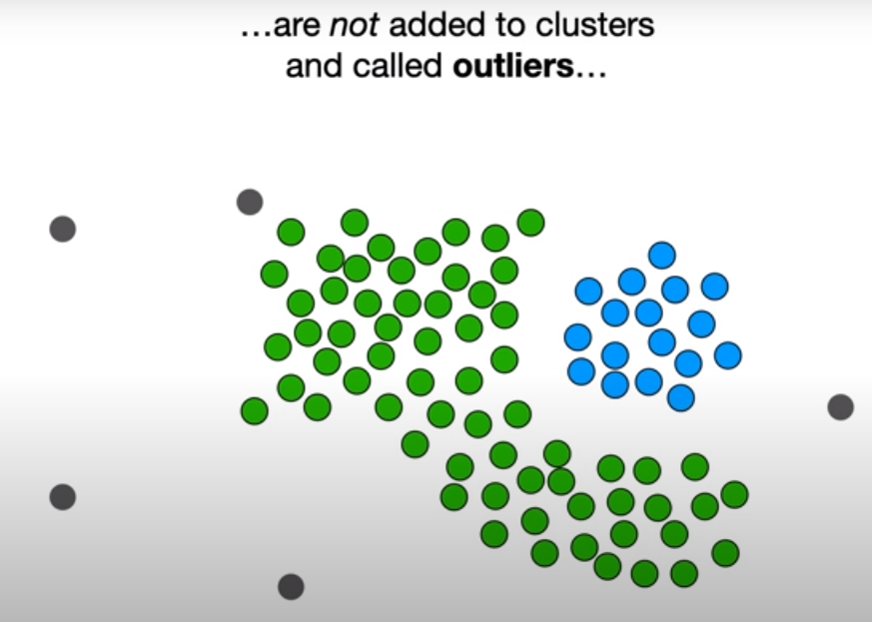
DBSCAN Clustering Algorithm

Slide 8
Today’s Lecture

Slide 9
Dimensionality Reduction
The input data fed to the model for training and then decision making.
Contain information
The complexity of any classifier or regressor depends on the number of inputs.
Dimensionality of input
Time and space complexity
Required number of training examples to train model.

Slide 10
Dimensionality Reduction
Why dimensionality reduction?
The complexity depends on the number of input dimensions (d)
Decreases the complexity
The size of the data sample (N)
Efficient memory and computation

Slide 11
Dimensionality Reduction
Why dimensionality reduction?
Redundant features must be removed.
BMI, Height, Weight
Simpler models are more robust on small datasets.
Fewer features can represent the data in effective way (if possible)
Hidden or latent factors
Easier data visualization with fewer dimensions

Slide 12
Dimensionality Reduction
How to perform dimensionality reduction?
Curse of Dimensionality
There are two main methods for reducing dimensionality:
Feature selection and feature extraction.
Feature selection:
Select a subset of features.
Finding k of the d dimensions that give us the most information
Feature extraction:
Finding a new set of k dimensions that are combinations of the original d dimensions.

Slide 13
Feature Selection
Select on a best subset of features from original data.
The best subset contains the least number of dimensions
Should not affect the accuracy.
Discard the remaining, unimportant dimensions.
Using a suitable error function to find best subset
Testing all features may be hard (polynomial time).

Slide 14
Feature Selection
There are two approaches for feature selection:
Forward Selection and Backward selection
Forward selection:, Start with no feature and add them one by one
Add the feature that decreases the error
Backward selection: Start with all features and remove them one by one.
Removing the one that decreases the error the most (or increases it only slightly).
Checking the error with a validation dataset

Slide 15
Feature Extraction
Component analysis is an unsupervised approach to finding the “right” features from the data.
One leading method for feature extraction
Principal component analysis (PCA)
PCA: Represent the d-dimensional data in a lower-dimensional space.
Represent same data in a lower dimensional space
Should best describe original data.
Should maintain the variations in the original data
We standardize the data before applying PCA

Slide 16
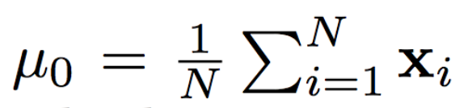
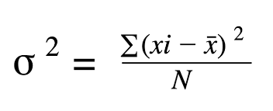
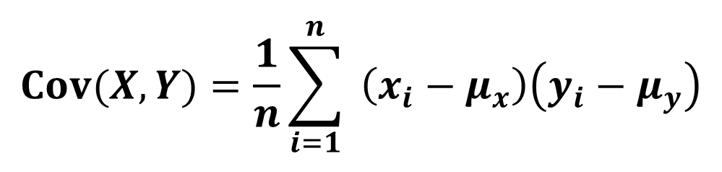
Feature Extraction
Mean
Variance
Covariance
$$Cov⁡(X,Y)=\frac{1}{n}\sum_{i=1}^{n}{ }\left(x_{i}−μ_{x}\right)\left(y_{i}−μ_{y}\right)$$

Slide 17
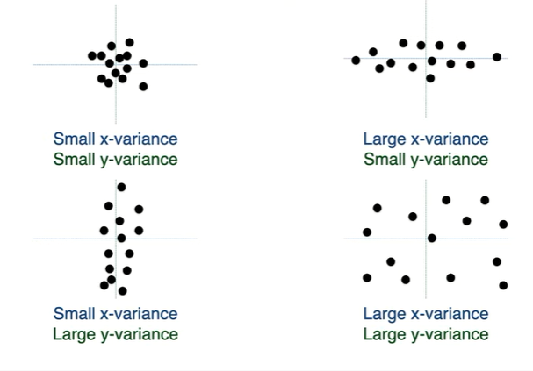
Basic Algebra

Slide 18
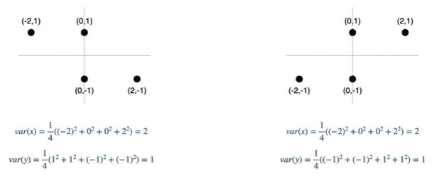
Basic Algebra

Slide 19

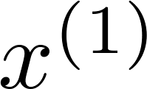
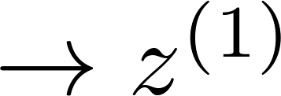
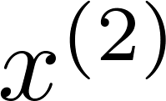
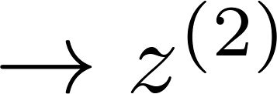
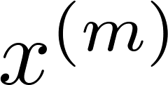
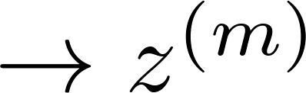


Data Compression
Reduce data from
2D to 1D
(inches)
(cm)
Andrew Ng
Notes:
Add more unique colors (3-4)

Slide 20
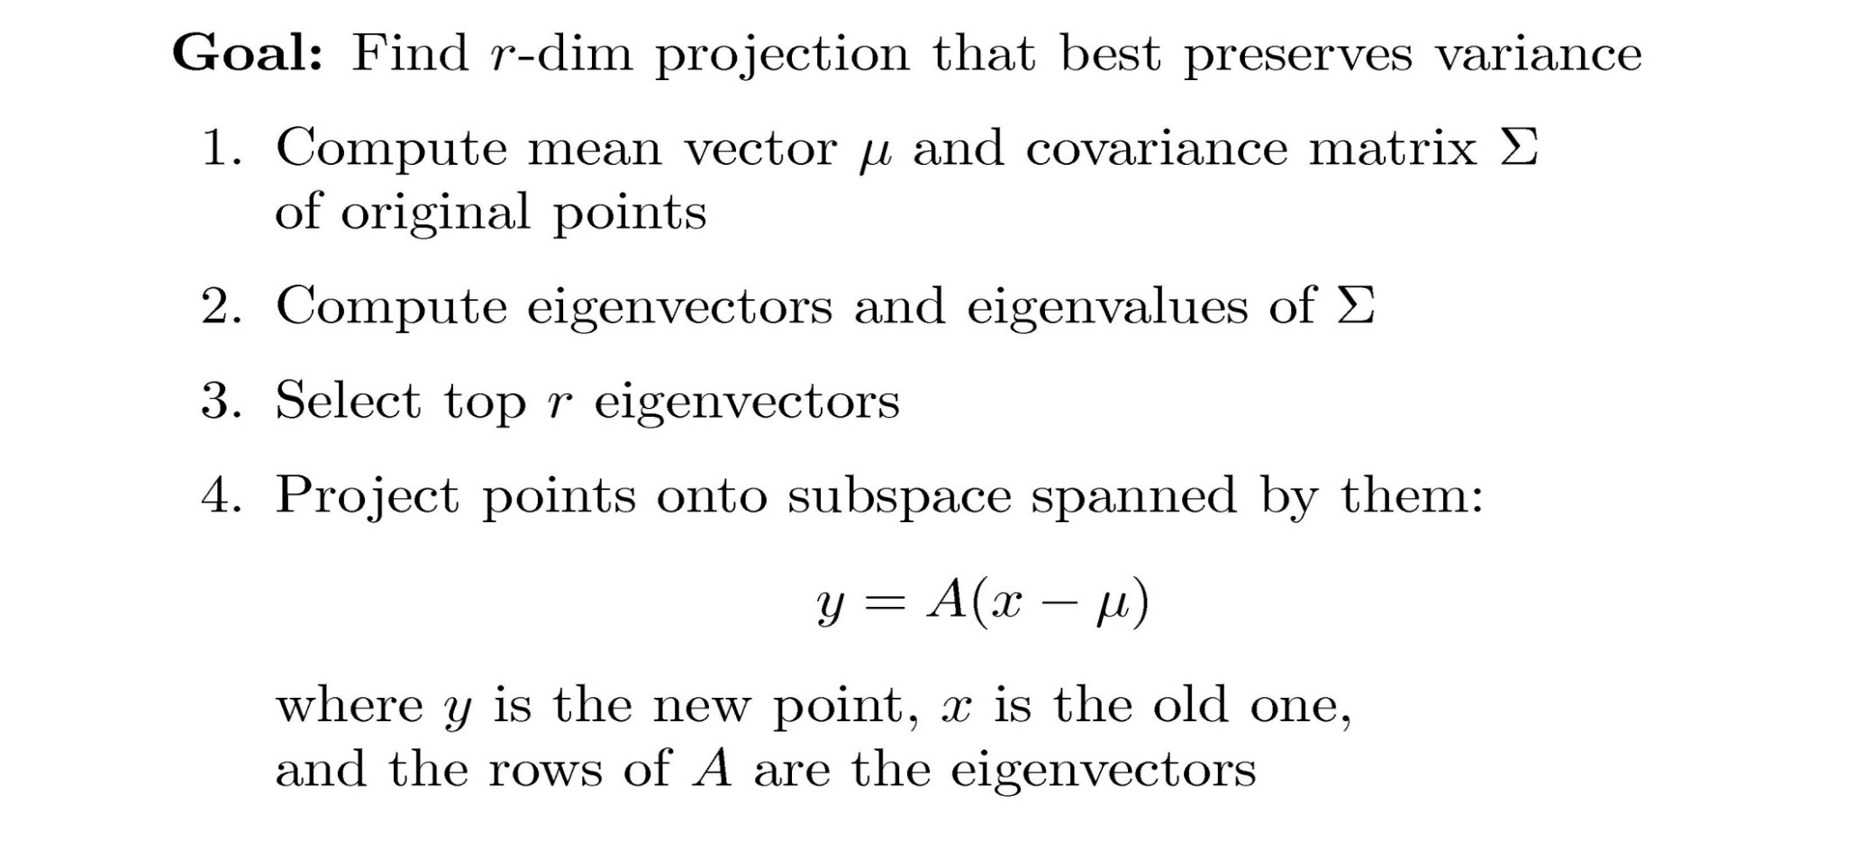
PCA Algorithm

Slide 21
Covariance
Variance and Covariance:
Measure of the “spread” of a set of points around their center of mass(mean)
Variance:
Measure of the deviation from the mean for points in one dimension
Covariance:
Measure of how much each of the dimensions vary from the mean with respect to each other
Covariance is measured between two dimensions
Covariance sees if there is a relation between two dimensions
Covariance between one dimension is the variance

Slide 22
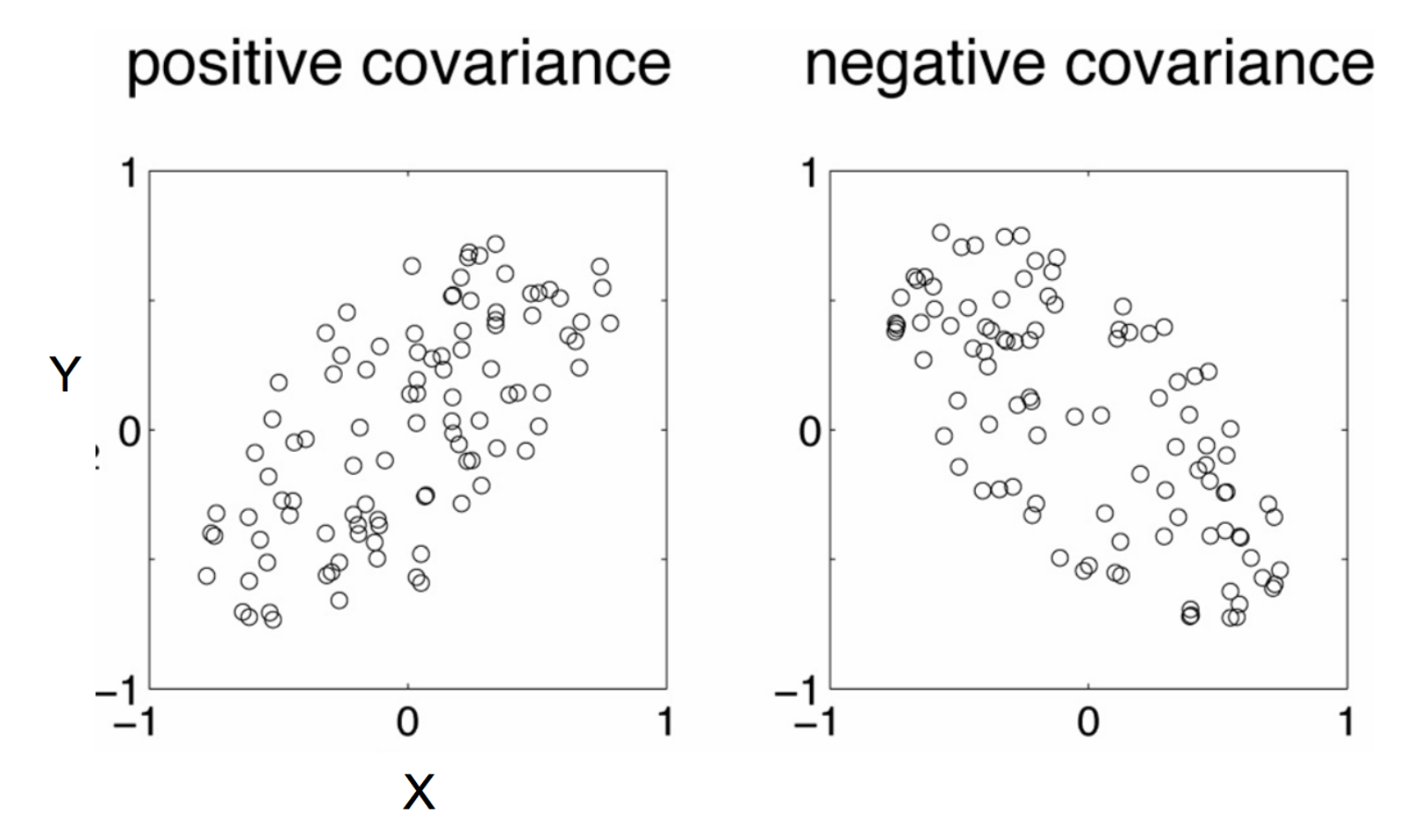
Positive: Both dimensions increase or decrease together
Negative: While one increase the other decrease

Slide 23
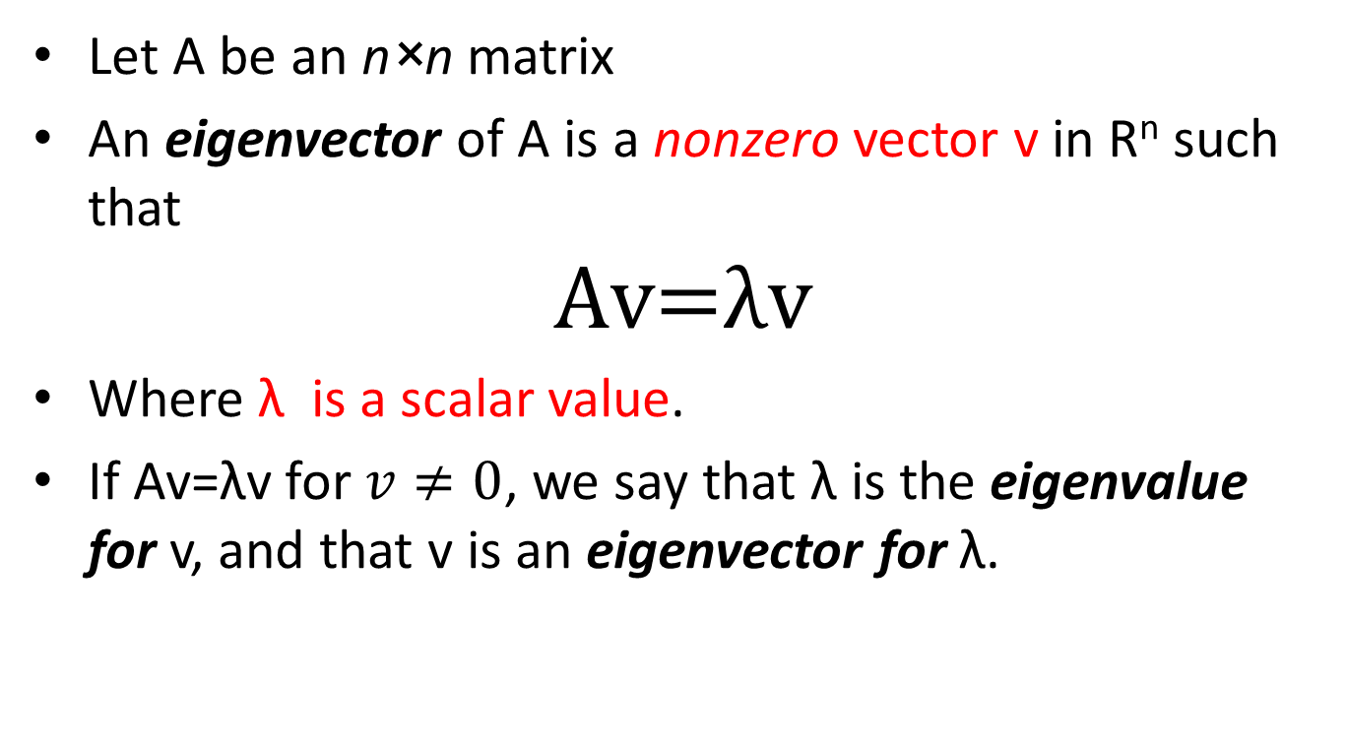
Eigenvector and Eigenvalue
Let A be an n×n matrix
An eigenvector of A is a nonzero vector v in R^{n} such that
$$\text{Av}\text{=}\text{λv}$$
Where λ is a scalar value.
If Av=λv for $v≠0$, we say that λ is the eigenvalue for v, and that v is an eigenvector for λ.

Slide 24
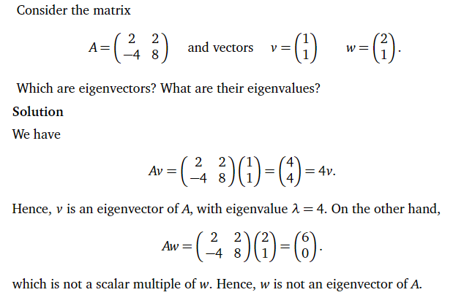
Eigenvector and Eigenvalue

Slide 25
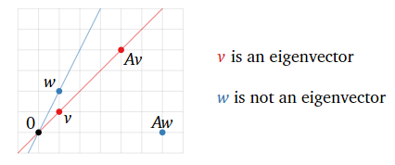
Eigenvector and Eigenvalue

Slide 26
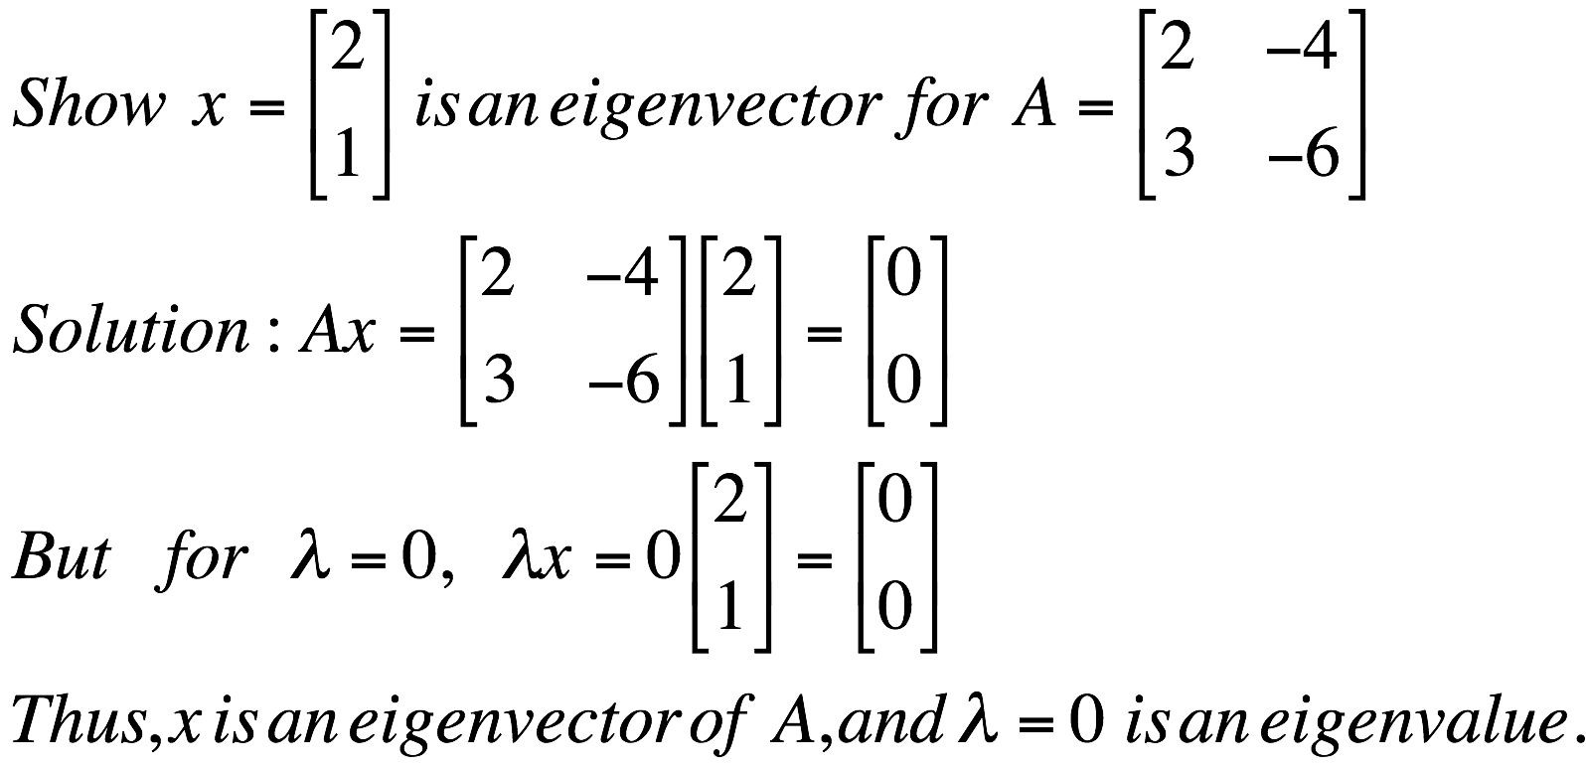
Eigenvector and Eigenvalue
A: Square Matrix
λ: Eigenvector or characteristic vector
X: Eigenvalue or characteristic value
Ax = λx
Example

Slide 27
Eigenvector and Eigenvalue
Ax - λx = 0
(A – λI)x = 0
Ax = λx
x will be an eigenvector of A if and only if B does not have an inverse, or equivalently det(B)=0 :
det(A – λI) = 0

Slide 28
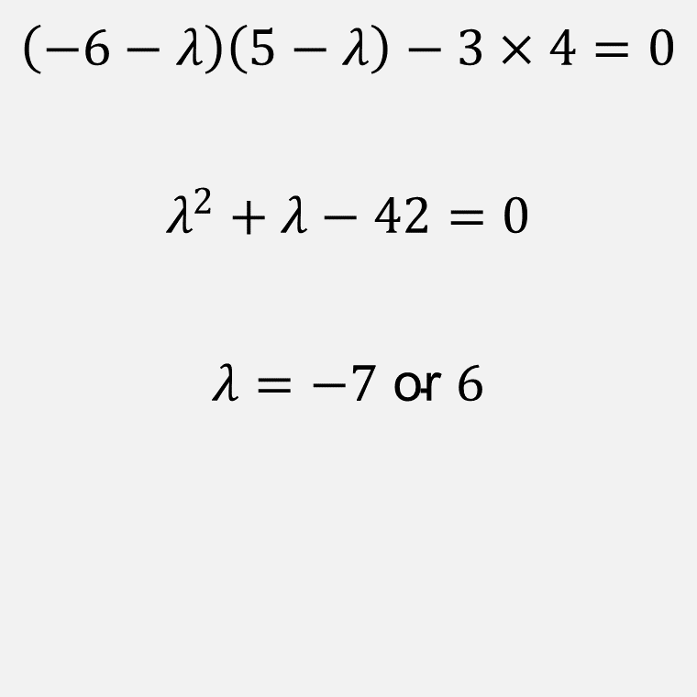
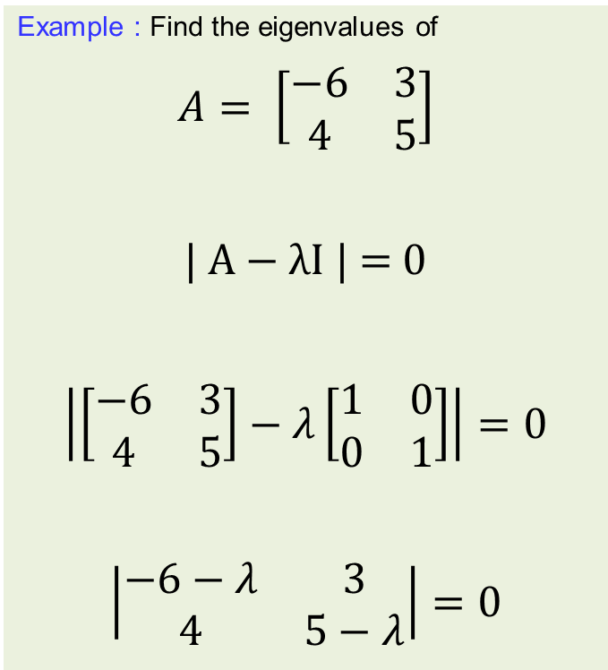
Eigenvector and Eigenvalue
Example : Find the eigenvalues of
$$A= \left[\begin{matrix}−6 & 3 \\ 4 & 5\end{matrix}\right]$$
| A − λI | = 0
$$\left|\left[\begin{matrix}−6 & 3 \\ 4 & 5\end{matrix}\right]−λ\left[\begin{matrix}1 & 0 \\ 0 & 1\end{matrix}\right]\right|=0$$
$$\left|\begin{matrix}−6−λ & 3 \\ 4 & 5−λ\end{matrix}\right|=0$$
$$\left(−6−λ\right)\left(5−λ\right)−3×4=0$$
$$λ^{2}+λ−42=0$$
$$λ=−7 \text{or} 6$$

Slide 29
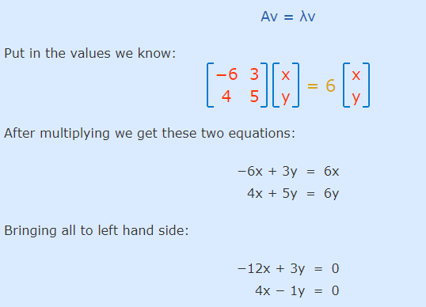
Eigenvector and Eigenvalue

Slide 30
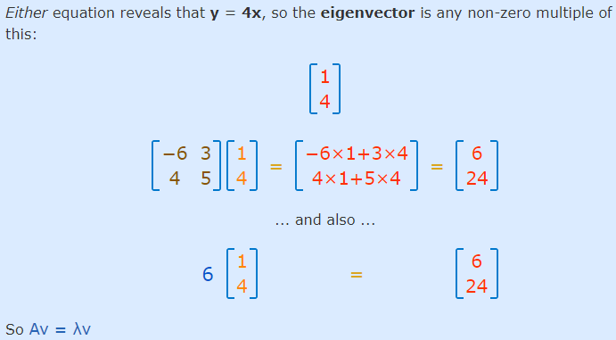
Eigenvector and Eigenvalue

Slide 31


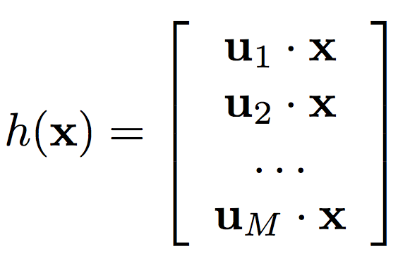

Principal Component Analysis
Input:
Set of basis vectors:
Summarize a D dimensional vector X with K dimensional feature vector h(x)

Slide 32
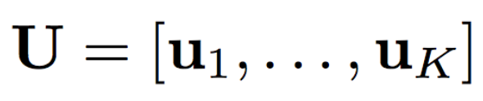
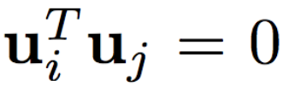
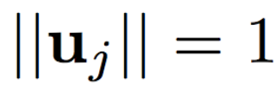

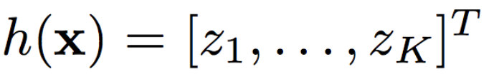
Principal Component Analysis
Basis vectors are orthonormal
New data representation h(x)

Slide 33
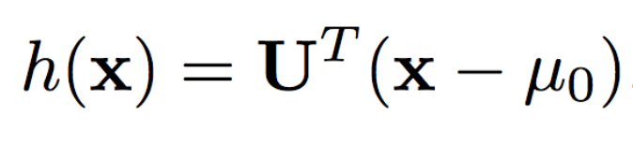
Principal Component Analysis
New data representation h(x)
Empirical mean of the data

Slide 34
References
Numerical Examples
https://medium.com/analytics-vidhya/understanding-principle-component-analysis-pca-step-by-step-e7a4bb4031d9
For various Mathematical Visualization
https://www.3blue1brown.com/

Slide 35
Thank You ☺

